Slide 1






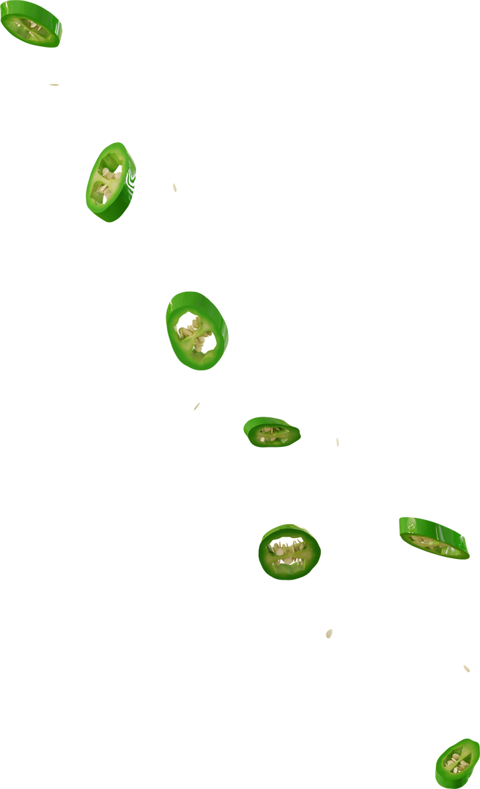


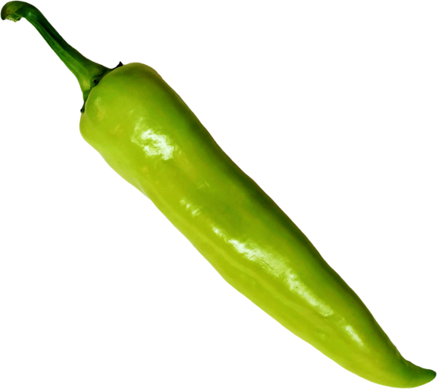
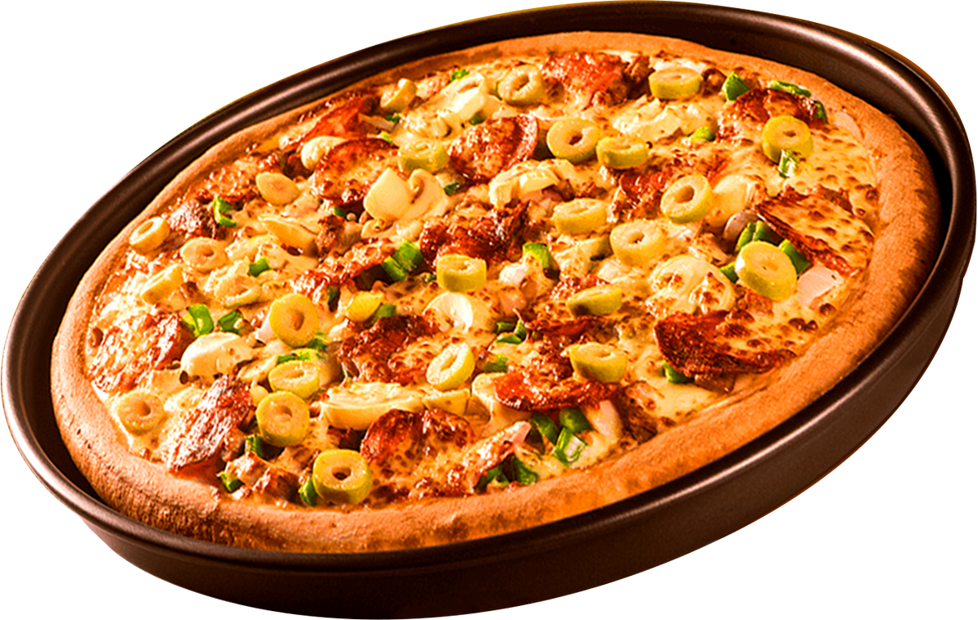
Technical Implementation
Future Enhancements
Teamwork
OVERVIEW
Key features
Challenges
world of flavors
World of flavors
https://theworldofrecipes.kesug.com

Slide 2

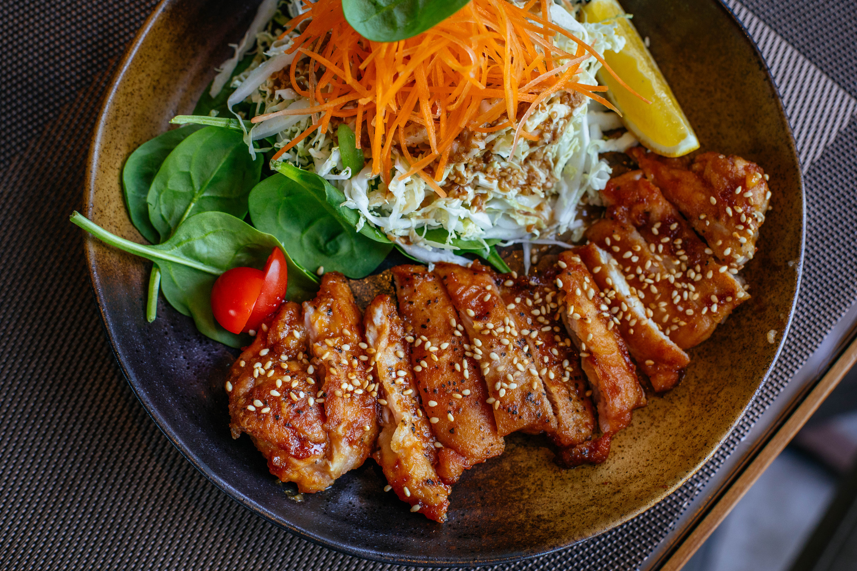
Technical Implementation
Future Enhancements
Teamwork
World of flavors
OVERVIEW
Key features
Challenges
overview
Purpose:
Provide an easy-to-use platform for users to browse recipes, view details, and add new recipes.
Uniqueness:
Introduce an innovative feature – the Smart Recipe Builder – which helps users find recipes that match the ingredients they already have.
Benefit:
Users can quickly obtain recipes that fit their available ingredients without the need to search through hundreds of recipes. This makes the project practical and different from traditional recipe websites.

Slide 3

Technical Implementation
Future Enhancements
Teamwork
World of flavors
OVERVIEW
Key features
Challenges
Key features
01
A homepage displaying the latest recipes.
05
Login/Logout system using PHP Sessions.
02
A detailed page for each recipe (ingredients – preparation steps – image).
An admin dashboard showing statistics (number of users, number of recipes, today’s recipes) and allowing full CRUD operations (Add – Edit – Delete – View) for both users and recipes.
06
03
Ability to search for recipes by title or ingredients.
07
Smart Recipe Builder (Unique Feature):
Enter available ingredients.
Display matching recipes.
Sort results by compatibility percentage.
04
An “Add Recipe” page with image upload.

Slide 4









Technical Implementation
Future Enhancements
Teamwork
World of flavors
OVERVIEW
Key features
Challenges
Technical Implementation
PHP
Bootstrap & CSS
Form handling.
CRUD operations on the database.
Session management (Login/Logout).
Store recipe and user data.
Queries: SELECT, INSERT, UPDATE, DELETE.
Link recipes to users via Foreign Key.
MySQL
JavaScript
Responsive design for all devices.
Font Awesome icons for a modern interface.
Input validation.
Enhanced user experience (e.g., password strength indicator).

Slide 5




Technical Implementation
Future Enhancements
Teamwork
World of flavors
OVERVIEW
Key features
Challenges
Challenges
Image Management:
Handling image upload, size, and format.
✔ Solution: Validate file type and size before saving.
User Sessions:
Protecting admin-only pages.
✔ Solution: Use is_admin with sessions to control access.
Smart Recipe Builder
Efficiently searching text-based ingredients.
✔ Solution: Use dynamic queries with LIKE and OR.

Slide 6

Technical Implementation
Future Enhancements
Teamwork
World of flavors
OVERVIEW
Key features
Challenges
Future Enhancements
01
Add a commenting system for recipes.
03
Support for favorite recipes.
02
Mobile application: Android and iOS versions.
04
Add videos for recipes.

Slide 7
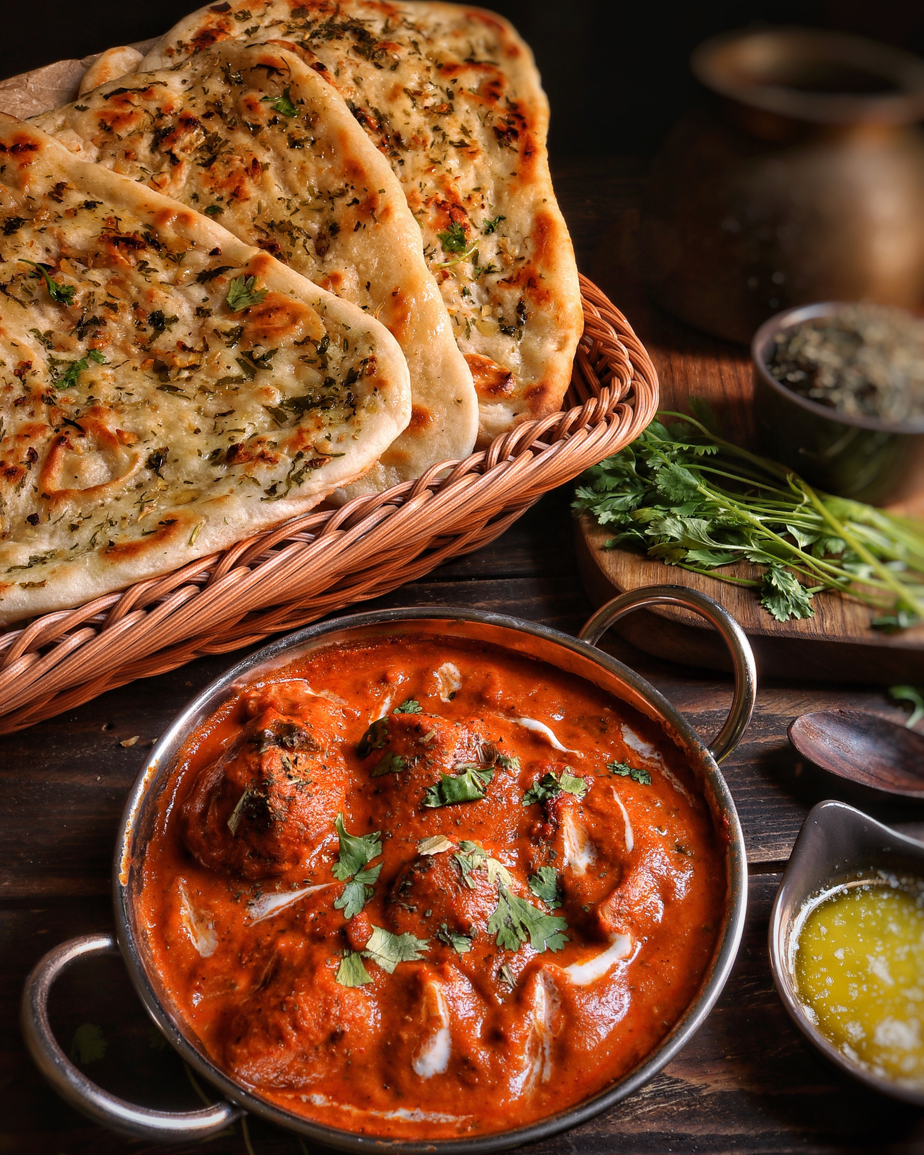
Technical Implementation
Future Enhancements
Teamwork
World of flavors
OVERVIEW
Key features
Challenges
Teamwork
The distribution was as follows:
JOOD:
Designed the user interface using Bootstrap & CSS.
JURI:
Built the database and integrated it with PHP.
RAGHAD:
Developed the Smart Recipe Builder feature.
ARJWAN:
Set up the admin dashboard and user management.

Slide 8


Technical Implementation
Future Enhancements
Teamwork
World of flavors
OVERVIEW
Key features
Challenges
Live Demo
Hosted Project Link: [https://theworldofrecipes.kesug.com]

Slide 9
World of flavors
THANK YOU FOR WATCHING

